Slide 1

NAME OF THE PROJECT
HOUSING PRICE PREDICTION PROJECT

Slide 2

House Price Prediction Projects

Slide 3
Table of Contents
Introduction
Problem Statement
Business Goal
Technical Requirements
Breakdown of the Problem Statement
Data Preparation
Exploratory Data Analysis
Prediction Type and Modeling Techniques
Model Building and Evaluation
Analysis and Comparison
Conclusion
References

Slide 4
Introduction
Thousands of houses are sold everyday. There are some questions every buyer asks himself like: What is the actual price that this house deserves? Am I paying a fair price? In this paper, a, the year it was built in, etc.). During the development and evaluation of our model, we will show the code machine learning model is proposed to predict a house price based on data related to the house (its size used for each step followed by its output. This will facilitate the reproducibility of our work. In this study, Python programming language with a number of Python packages will be used.

Slide 5
Problem Statement
Houses are one of the necessary need of each and every person around the globe and therefore housing and real estate market is one of the markets which is one of the major contributors in the world’s economy. It is a very large market and there are various companies working in the domain. Data science comes as a very important tool to solve problems in the domain to help the companies increase their overall revenue, profits, improving their marketing strategies and focusing on changing trends in house sales and purchases. Predictive modeling, Market mix modeling, recommendation systems are some of the machine learning techniques used for achieving the business goals for housing companies. Our problem is related to one such housing company. A US-based housing company named Surprise Housing has decided to enter the Australian market. The company uses data analytics to purchase houses at a price below their actual values and flip them at a higher price. For the same purpose, the company has collected a data set from the sale of houses in Australia. The data is provided in the CSV file below. The company is looking at prospective properties to buy houses to enter the market. You are required to build a model using Machine Learning in order to predict the actual value of the prospective properties and decide whether to invest in them or not. For this company wants to know:
Which variables are important to predict the price of variable?
How do these variables describe the price of the house?

Slide 6
Business Goal
You are required to model the price of houses with the available independent variables. This model will then be used by the management to understand how exactly the prices vary with the variables. They can accordingly manipulate the strategy of the firm and concentrate on areas that will yield high returns. Further, the model will be a good way for the management to understand the pricing dynamics of a new market.

Slide 7
Technical Requirements
Data contains 1460 entries each having 81 variables.
Data contains Null values. You need to treat them using the domain knowledge and your own understanding.
Extensive EDA has to be performed to gain relationships of important variable and price.
Data contains numerical as well as categorical variable. You need to handle them accordingly.
You have to build Machine Learning models, apply regularization and determine the optimal values of Hyper Parameters.
You need to find important features which affect the price positively or negatively.
Two datasets are being provided to you (test.csv, train.csv). You will train on train.csv dataset and predict on test.csv file.

Slide 8
Breakdown of the Problem Statement
Supervised machine learning problem.
Linear Regression.
The target value will be Sale Price

Slide 9
Goals of the Study
The main objectives of this study are as follows:
To apply data preprocessing and preparation techniques in order to obtain clean data
To build machine learning models able to predict house price based on house features
To analyze and compare models performance in order to choose the best model

Slide 10
Data Preparation
In this study, we will use a housing dataset presented by De Cock (2011). This dataset describes the sales of residential units in Ames, Iowa starting from 2006 until 2010. The dataset contains a large number of variables that are involved in determining a house price. We obtained a csv copy of the data from https://www.kaggle.com/prevek18/ames-housing-dataset

Slide 11
Reading the Dataset
The first step is reading the dataset from the csv file we downloaded.
We will use the read_csv() function from Pandas Python package
import pandas as pd df=pd.read_csv("train.csv") df.head()
Getting A Feel of the Dataset Let's display the first few rows of the dataset to get a feel of it

Slide 12
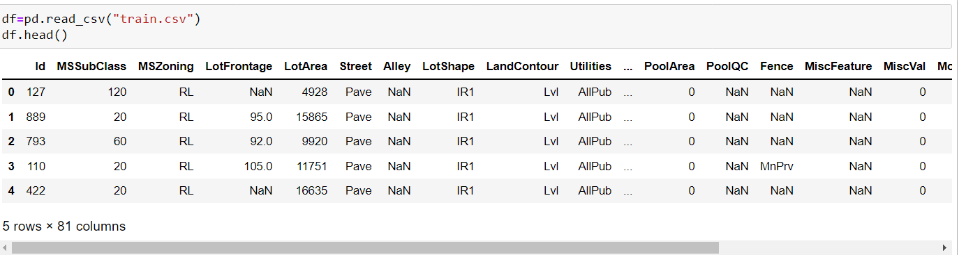
Reading the Dataset

Slide 13
Exploratory data analysis
Exploratory Data Analysis or EDA is very crucial for the success of all data science projects. It is an approach to analyze and understand the various aspects of the data.

Slide 14
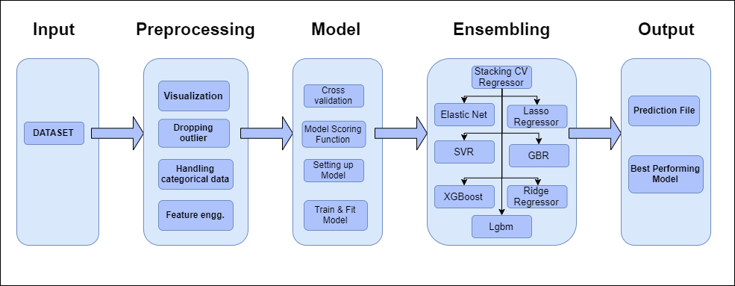
Flow chart

Slide 15
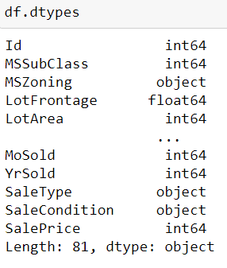
Check the dypes of data

Slide 16
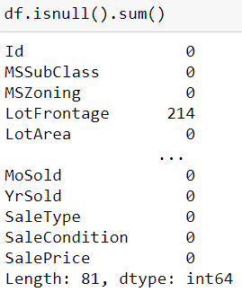
Check the null value counts

Slide 17
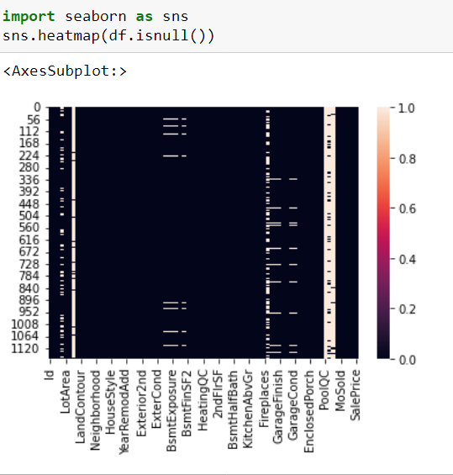
Check the null through heatmap

Slide 18
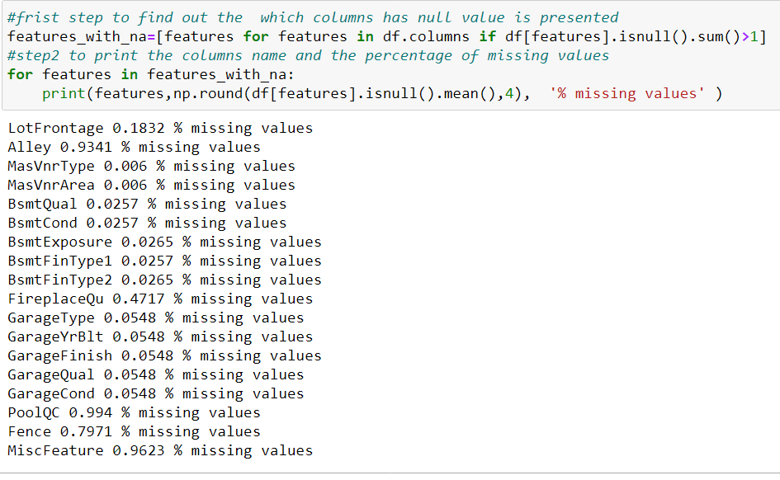
Check the percentage of null value

Slide 19
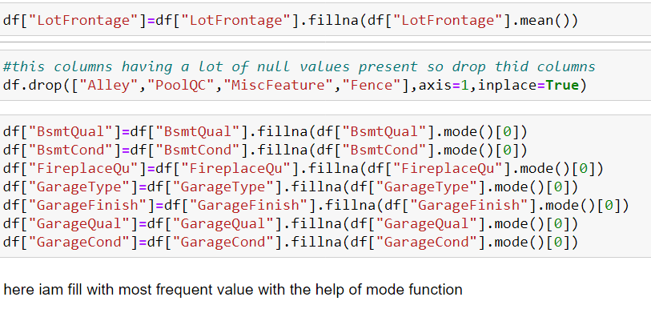
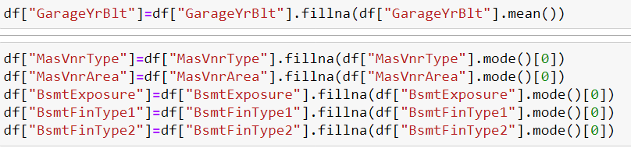
To fillip the null values

Slide 20
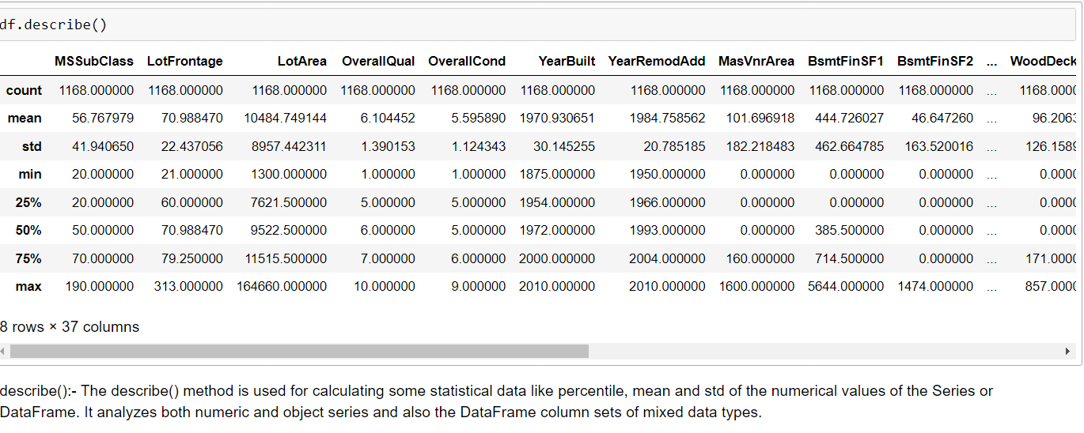
Statistical summary

Slide 21
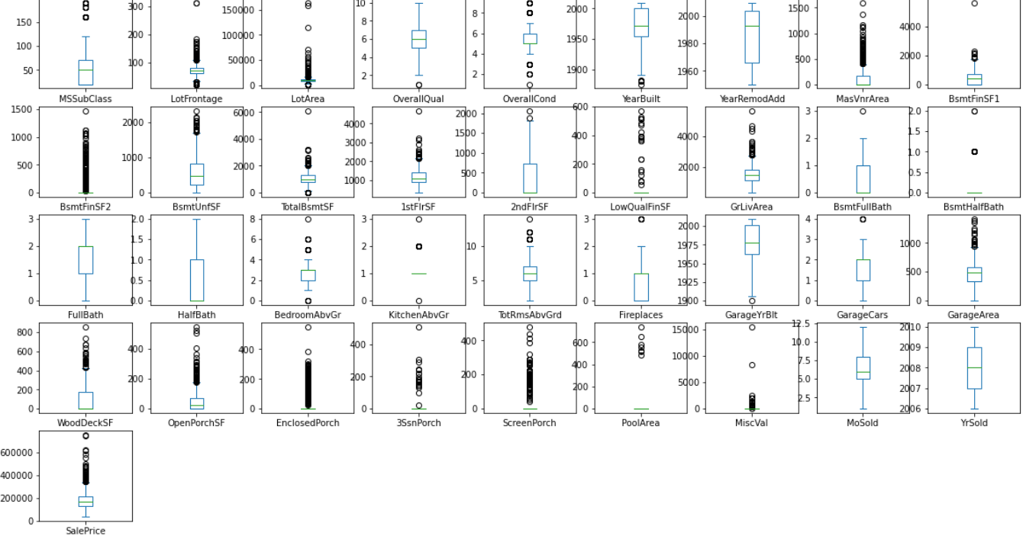
Detect the outliers with box plot

Slide 22
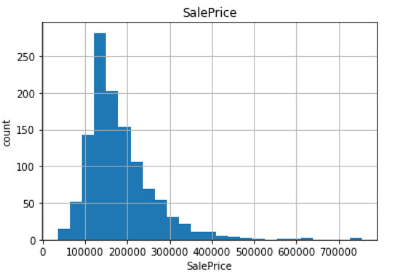
Sale price of house
We can see that most house prices fall between 100,000 and 200,000. We see also that there is a number of expensive houses to the right of the plot

Slide 23
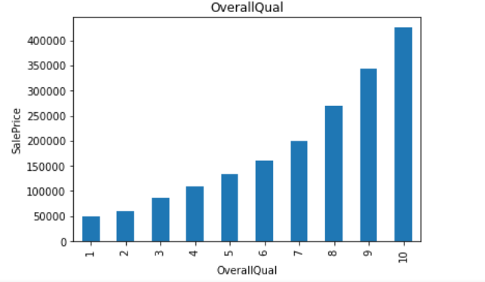
OverallQual of house
We see that Overall Qual takes an integer value between 1 and 10, and that most houses have an overall quality between 5 and 10.

Slide 24
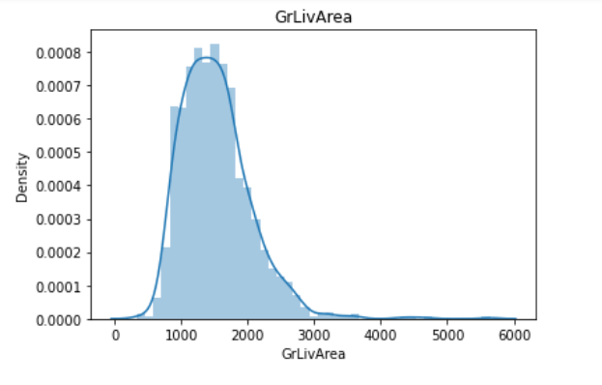
Ground living area
We can see that the above-ground living area falls approximately between 800 and 1800 ft².

Slide 25
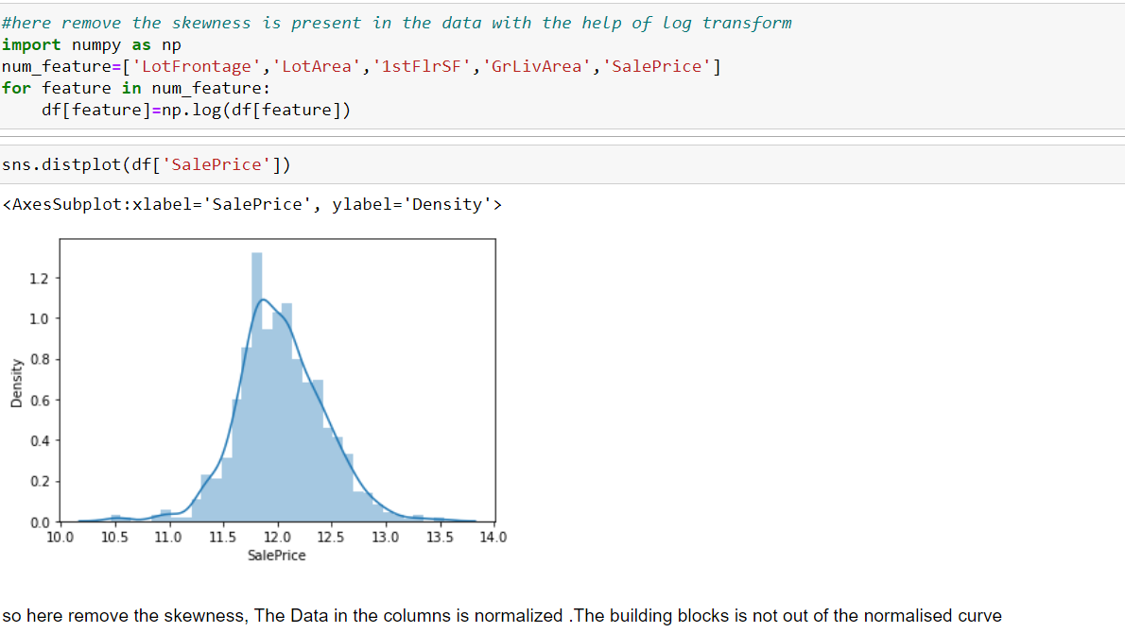
Remove the skewness

Slide 26
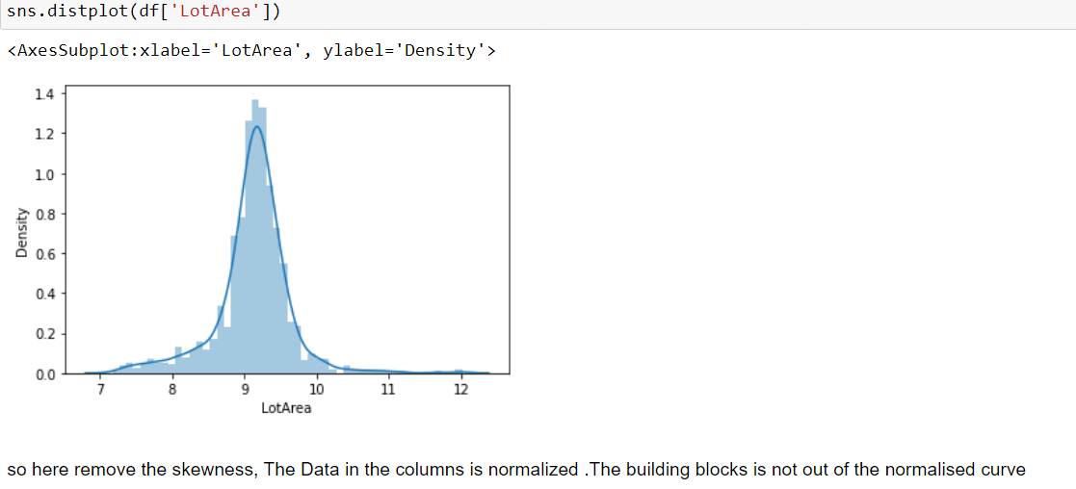
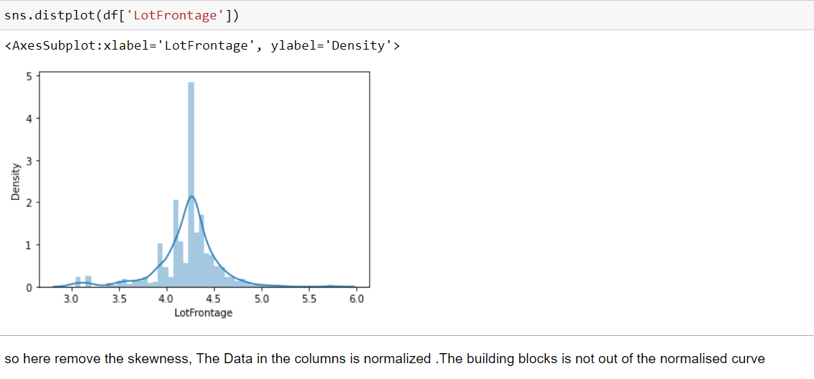

Slide 27
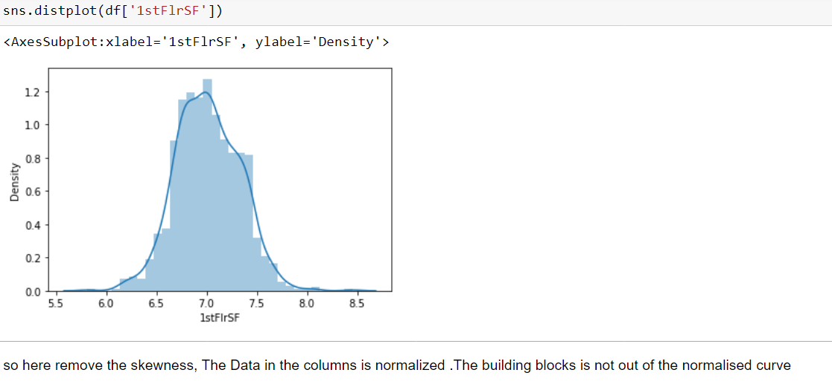
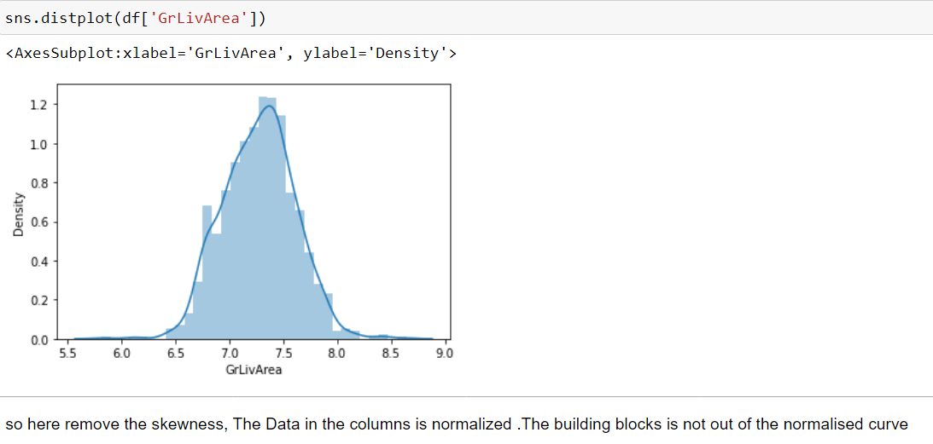

Slide 28
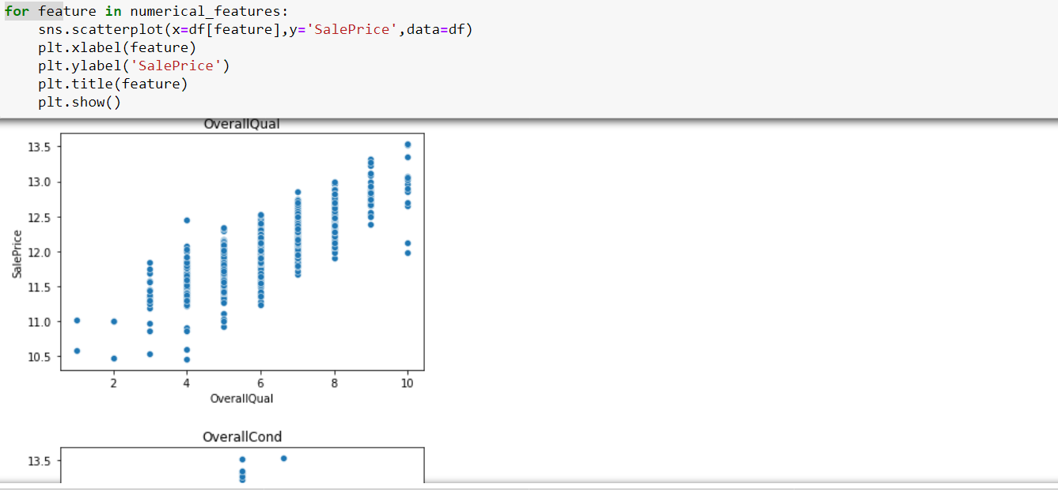
Scatter plot of sale price and OverallQual
We can see that they are truly positively correlated; generally, as the overall quality increases, the sale price increases too. This verifies what we got from the heat map

Slide 29
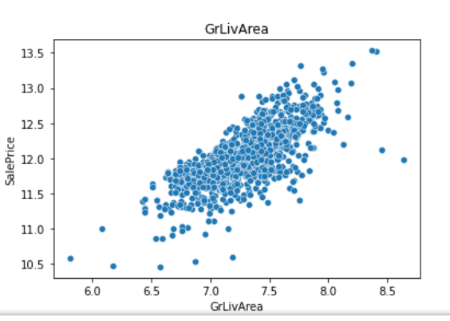
Scatter plot
The scatter plot above shows clearly the strong positive correlation between Gr Liv Area and Sale Price

Slide 30
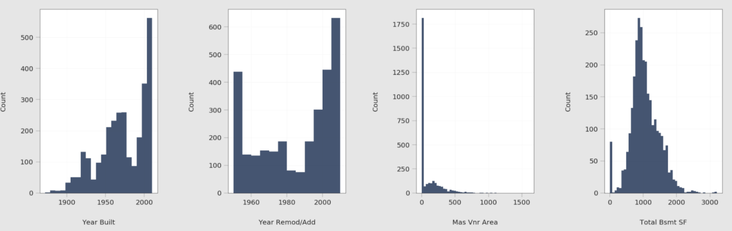
Moderate Positive Correlation
Next, we want to visualize the relationship between the target variable and the variables that are positively correlated with it, but the correlation is not very strong. Namely, these variables are Year Built, Year Remod/Add, Mas Vnr Area, Total Bsmt SF, 1st Flr SF, Full Bath, Garage Cars, and Garage Area. We start with the first four. Let us see the distribution of each of them:

Slide 31
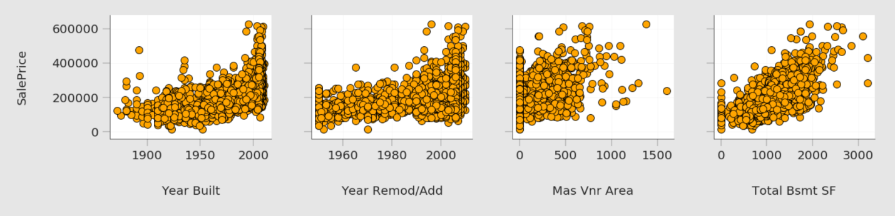
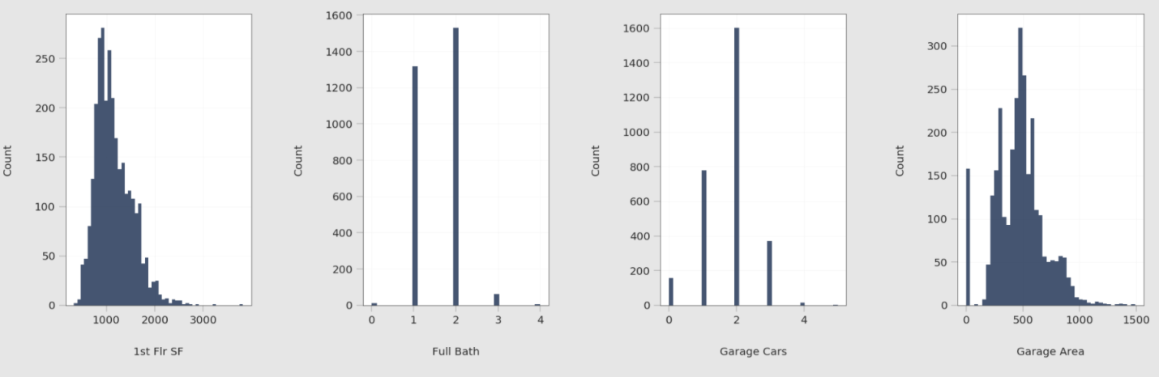
Relationship with target variables
And now let us see their relationships with the target variable:

Slide 32
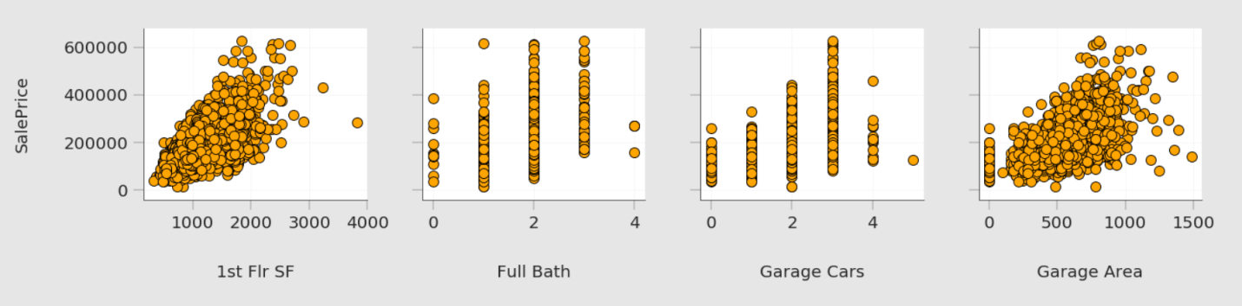
Relationship with target variables
From the plots above, we can see that these eight variables are truly positively correlated with the target variable. However, it's apparent that they are not as highly correlated as Overall Qual and Gr Liv Area.

Slide 33
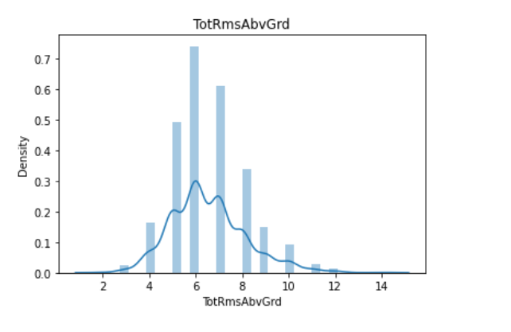
Positive Correlation
Apart from the target variable, when we plotted the heatmap, we discovered a high positive correlation between Garage Cars and Garage Area and between Gr Liv Area and TotRms AbvGrd. We want to visualize these correlations also. We've already seen the distribution of each of them except for TotRms AbvGrd. Let us see the distribution of TotRms AbvGrd first:

Slide 34
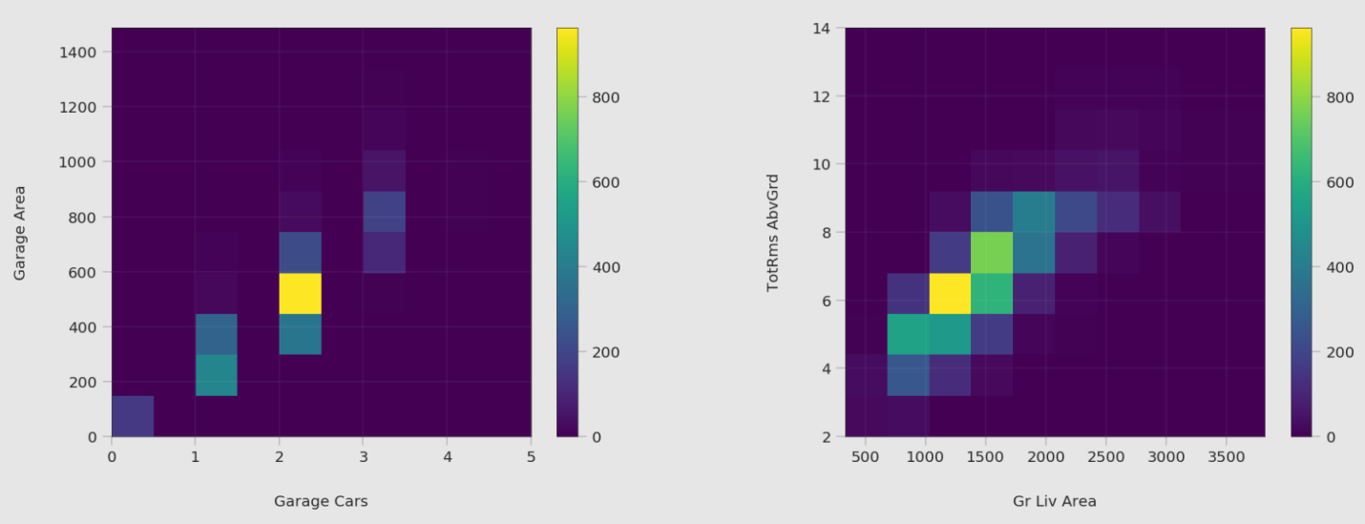
Positive Correlation
We can see the strong correlation between each pair. For Garage Cars and Garage Area, we see that the highest concentration of data is when Garage Cars is 2 and Garage Area is approximately between 450 and 600 ft². For Gr Liv Area and TotRms AbvGrd, we notice that the highest concentration is when Garage Liv Area is roughly between 800 and 2000 ft² and TotRms AbvGrd is 6.

Slide 35
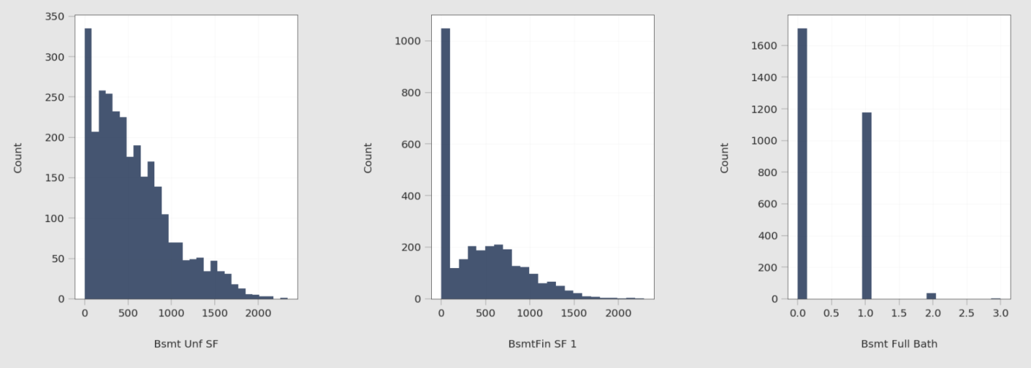
Negative Correlation
When we plotted the heatmap, we also discovered a significant negative correlation between Bsmt Unf SF and BsmtFin SF 1, and between Bsmt Unf SF and Bsmt Full Bath. We also want to visualize these correlations. Let us see the distribution of these variables first:

Slide 36
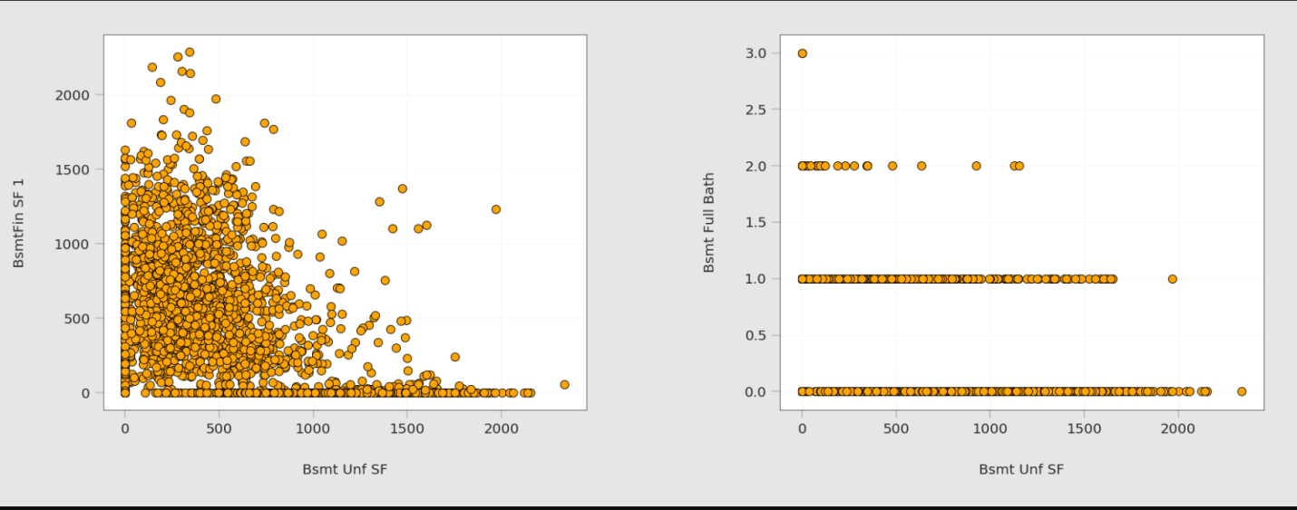
Relationship
Now, we visualize the relationship between each pair using scatter plots:

Slide 37
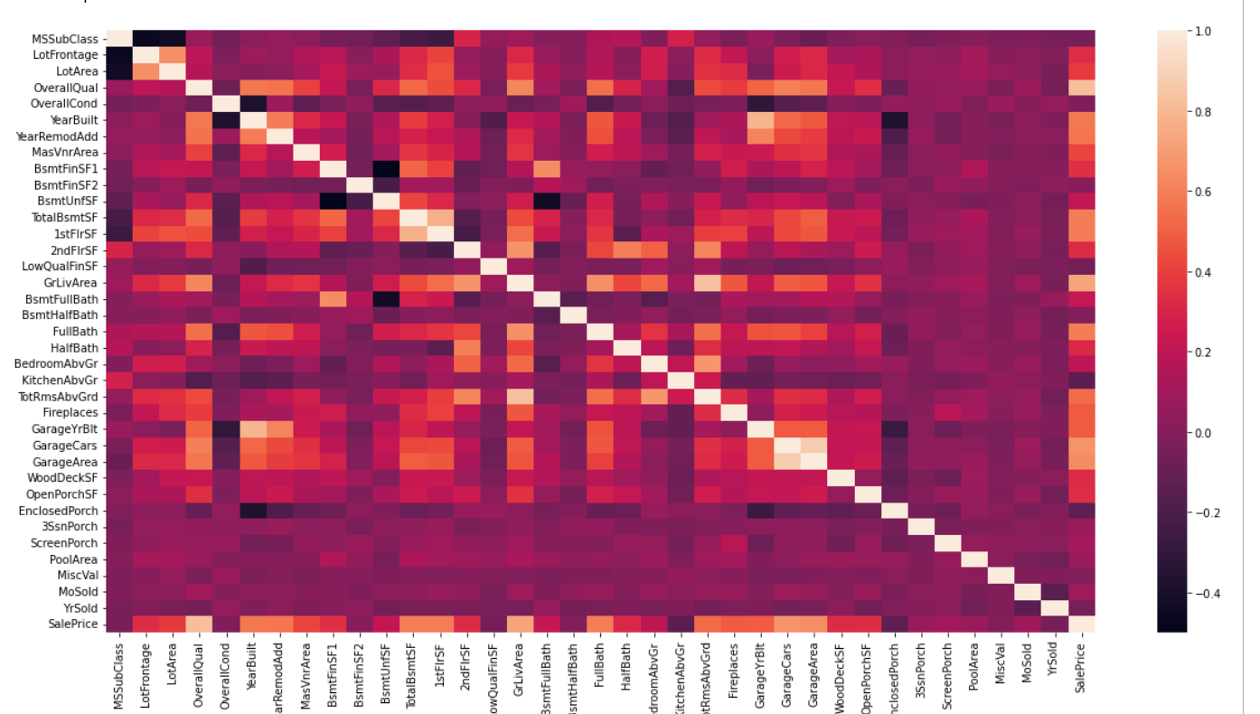
Correlation Between Variables
We want to see how the dataset variables are correlated with each other and how predictor variables are correlated with the target variable. For example, we would like to see how Lot Area and Sale Price are correlated: Do they increase and decrease together (positive correlation)? Does one of them increase when the other decrease or vice versa (negative correlation)? Or are they not correlated?

Slide 38
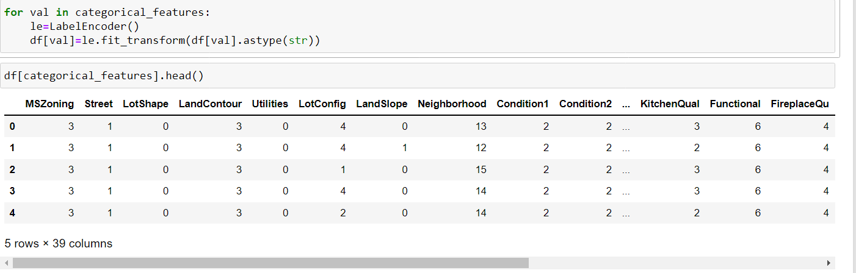
Feature Engineering
Feature Engineering with categorical variables using label encoder.
Label Encoder encode labels with a value between 0 and n_classes-1 where n is the number of distinct labels. If a label repeats it assigns the same value to as assigned earlier.

Slide 39
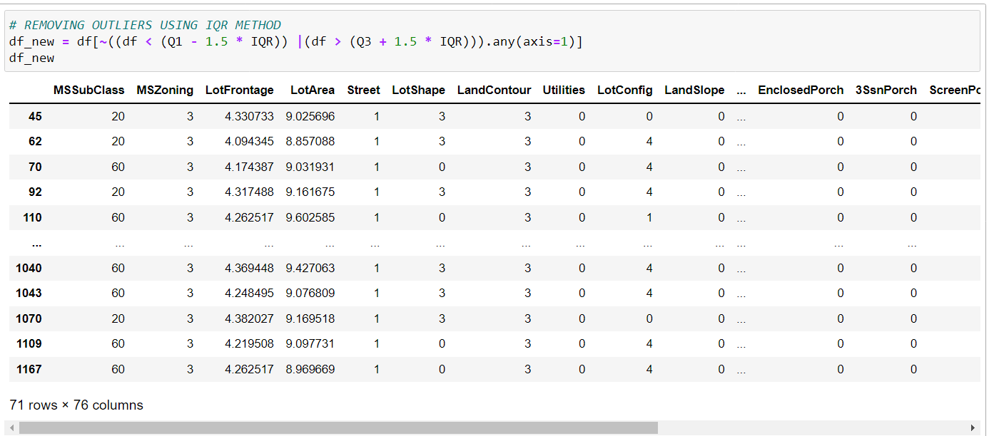
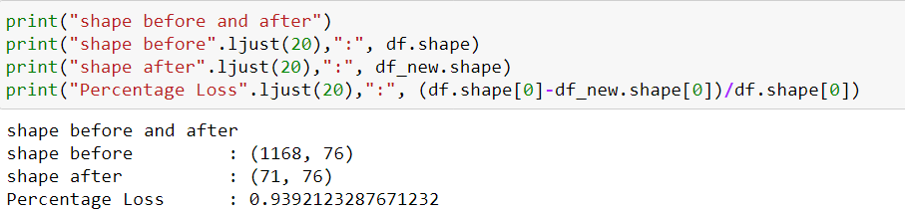
Outliers removal
Outliers can be removed from the data using statistical methods of IQR, Z-Score and Data Smoothing.
For claculating IQR of a dataset first calculate it's 1st Quartile(Q1) and 3rd Quartile(Q3) i.e. 25th and 75 percentile of the data and then subtract Q1 from Q3.

Slide 40
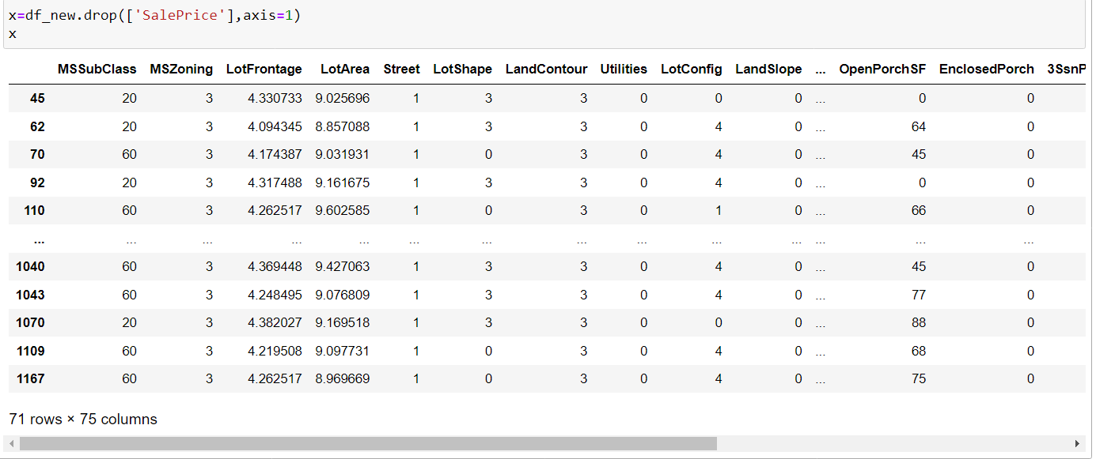
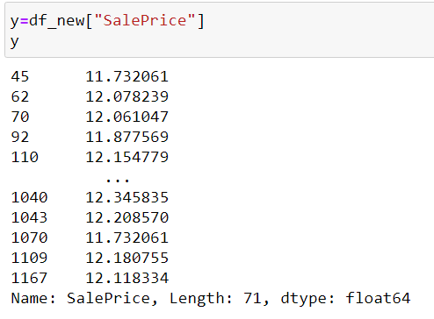
Now divide the train data in x,y
Now divide the data in a x,y
X is include all variables excluding target variable
Y is a target variable

Slide 41
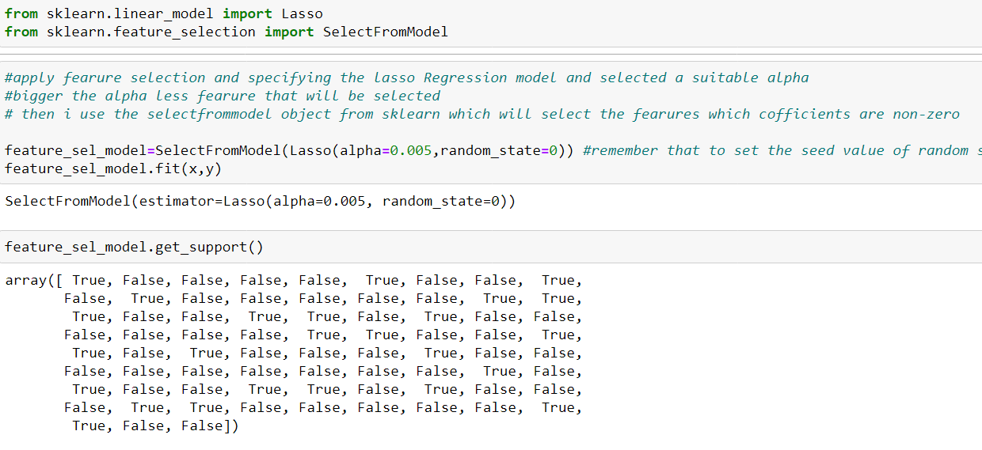
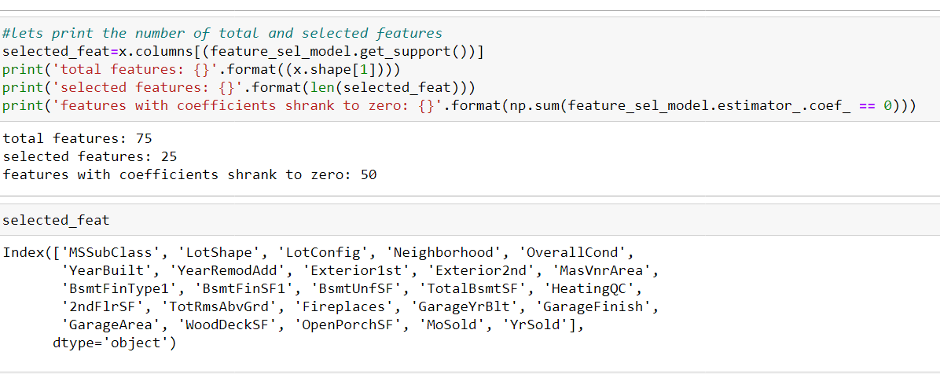
Feature Selection
apply feature selection and specifying the lasso Regression model and selected a suitable alpha
bigger the alpha less feature that will be selected
then I use the selectfrommodel object from sklearn which will select the features which coefficients are non-zero

Slide 42
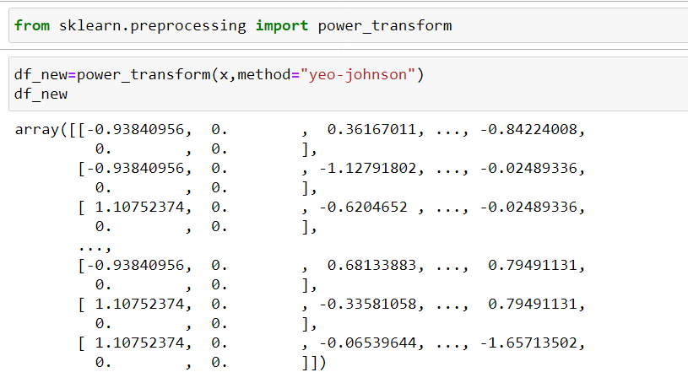
Remove the skewness
Power transforms are a family of parametric, monotonic transformations that are applied to make data more Gaussian-like. This is useful for modeling issues related to heteroscedasticity (non-constant variance), or other situations where normality is desired.
Currently, power transform supports the Box-Cox transform and the Yes-Johnson transform. The optimal parameter for stabilizing variance and minimizing skewness is estimated through maximum likelihood.
Box-Cox requires input data to be strictly positive, while Yes-Johnson supports both positive or negative data.
By default, zero-mean, unit-variance normalization is applied to the transformed data.

Slide 43
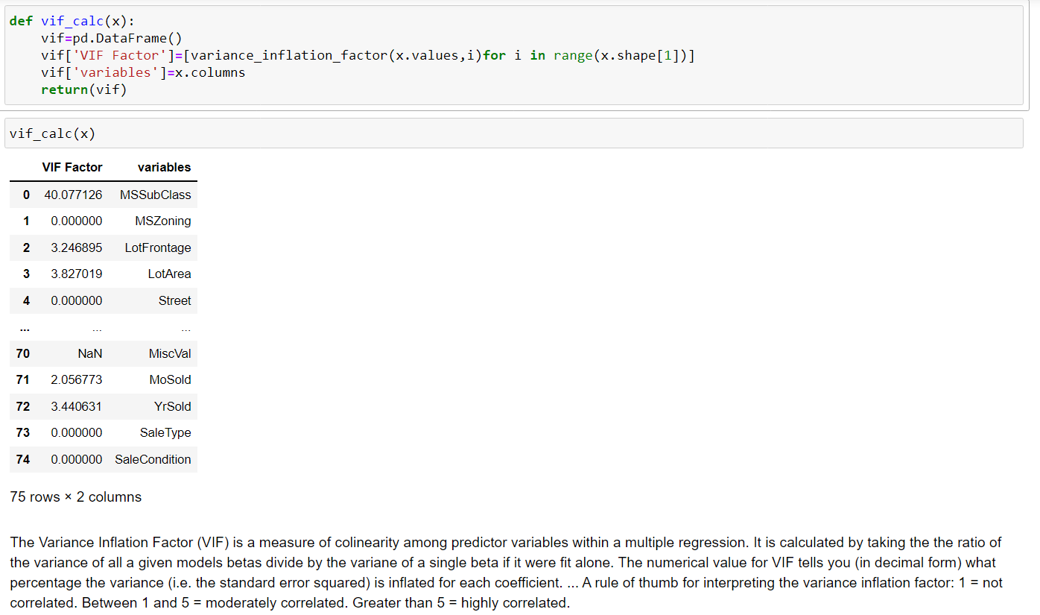
Find the vif
Mathematically, the VIF for a regression model variable is equal to the ratio of the overall model variance to the variance of a model that includes only that single independent variable. This ratio is calculated for each independent variable.

Slide 44
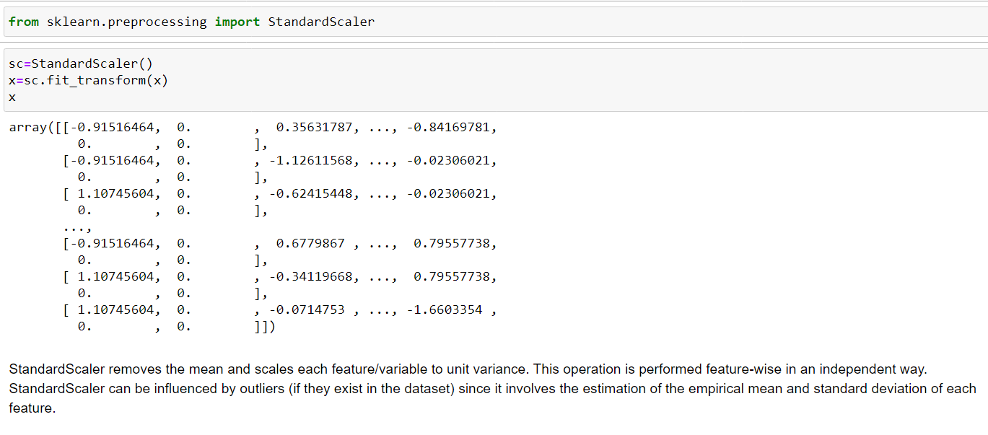
Feature scaling
standardize features by removing the mean and scaling to unit variance.
The standard score of a sample x is calculated as:
z = (x - u) / s
where u is the mean of the training samples or zero if with mean=False, and s is the standard deviation of the training samples or one if with_std=False.

Slide 45
Prediction Type and Modeling Techniques
In this section, we choose the type of machine learning prediction that is suitable to our problem. We want to determine if this is a regression problem or a classification problem. In this project, we want to predict the price of a house given information about it. The price we want to predict is a continuous value; it can be any real number. This can be seen by looking at the target variable in our dataset Sale Price:
That means that the prediction type that is appropriate to our problem is regression.
Now we move to choose the modeling techniques we want to use. There are a lot of techniques available f or regression problems like Linear Regression, Ridge Regression, Artificial Neural Networks, Decision Trees, Random Forest, etc. In this project, we will test many modeling techniques, and then choose the technique(s) that yield the best results.

Slide 46
Assumptions
This is a Linear Regression problem so we will use Regression methods.
Train test split will be a 75:25 ratio respectively

Slide 47
Models we will use:
Linear Regression
Lasso
Ridge
Elastic Net
DecisionTreeRegressor
KNeighborRegressor
SupportVectorRegressor
SGDRegressor
RandomForestRegressor
AdaBoostRegressor
GradientBoostRegressor
XGBRegressor

Slide 48
To find out?
r2_score:
coss_val_score:
Mean_squared_error:
Mean_absolute_error:
Root_mean_squared_error:

Slide 49
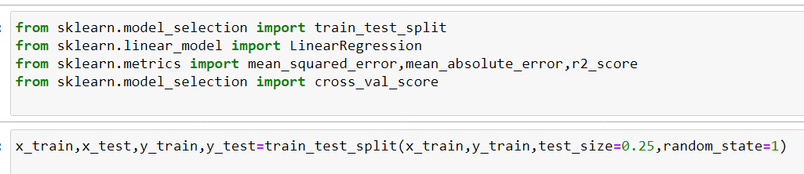
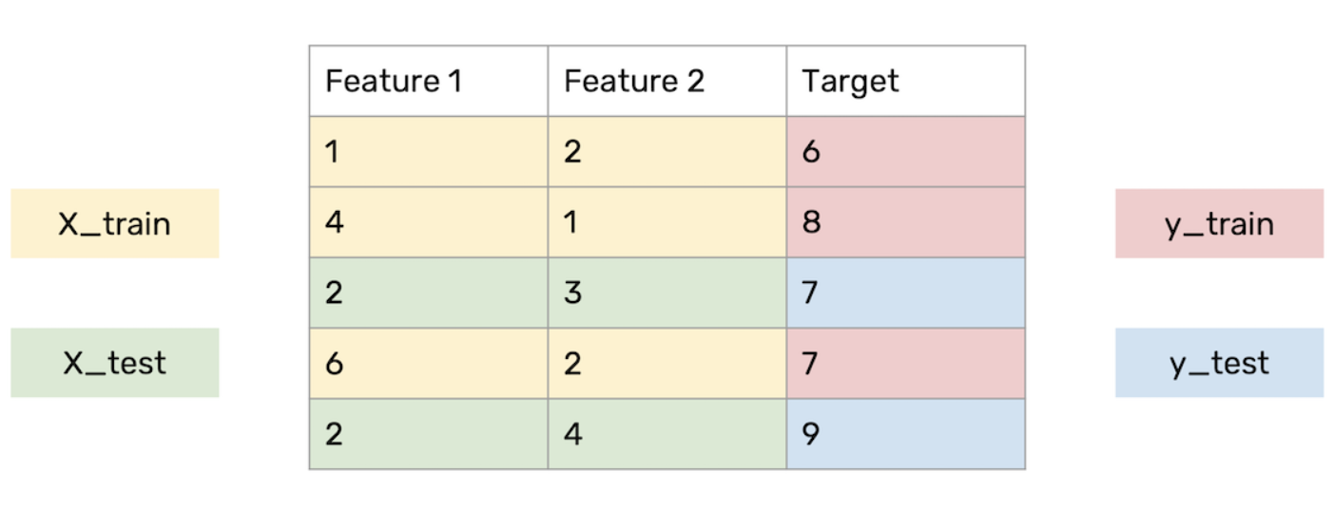
Splitting the Dataset
As usual for supervised machine learning problems, we need a training dataset to train our model and a test dataset to evaluate the model. So we will split our dataset randomly into two parts, one for training and the other for testing. For that, we will use another function from Scikit-Learn called train_test_split():
We specified the size of the test set to be 25% of the whole dataset. This leaves 75% for the training dataset. Now we have four subsets: X_train, X_test, y_train, and y_test. Later we will use X_train and y_train to train our model, and X_test and y_test to test and evaluate the model. X_train and X_test represent features (predictors); y_train and y_test represent the target. From now on, we will refer to X_train and y_train as the training dataset, and to X_test and y_test as the test dataset. Figure 10 shows an example of what train_test_split() does.

Slide 50
Modeling Approach
Choose an algorithm that implements the corresponding technique
Search for an effective parameter combination for the chosen algorithm
Create a model using the found parameters
Train (fit) the model on the training dataset
Test the model on the test dataset and get the results

Slide 51
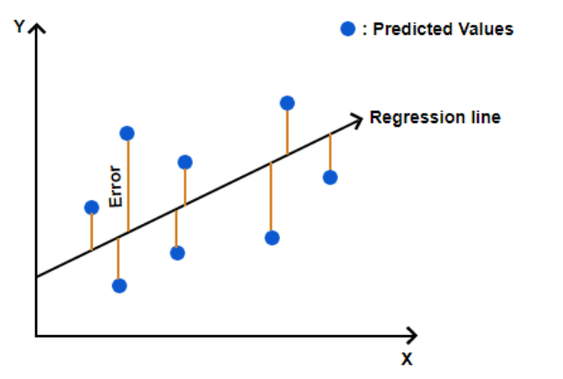
ElasticNetRegression
Elastic net is a popular type of regularized linear regression that combines two popular penalties, specifically the L1 and L2 penalty functions. ... Elastic Net is an extension of linear regression that adds regularization penalties to the loss function during training.

Slide 52
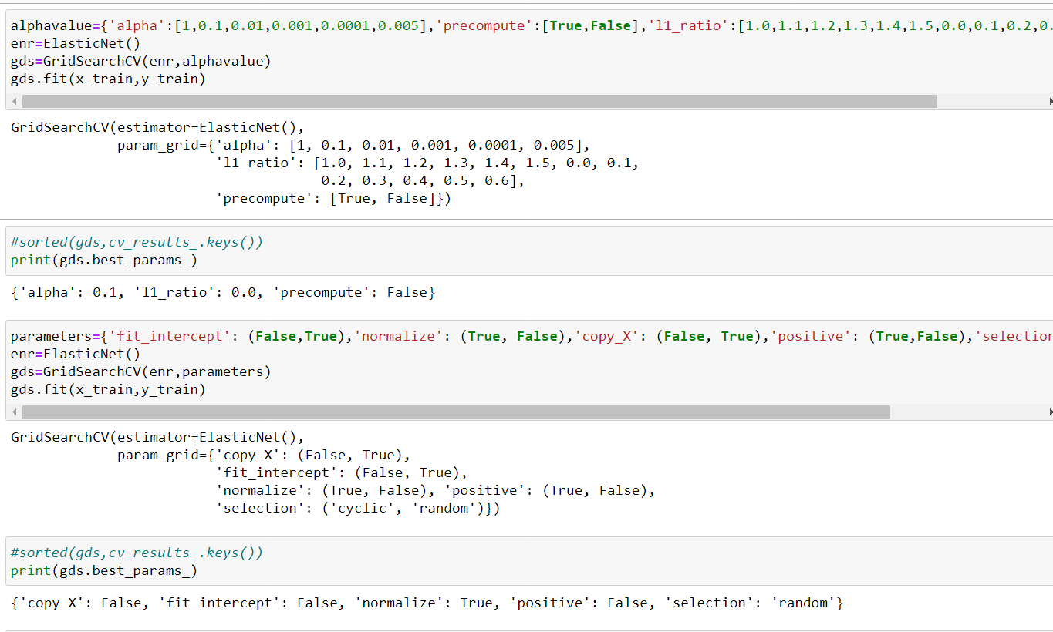
Searching for Effective Parameters

Slide 53
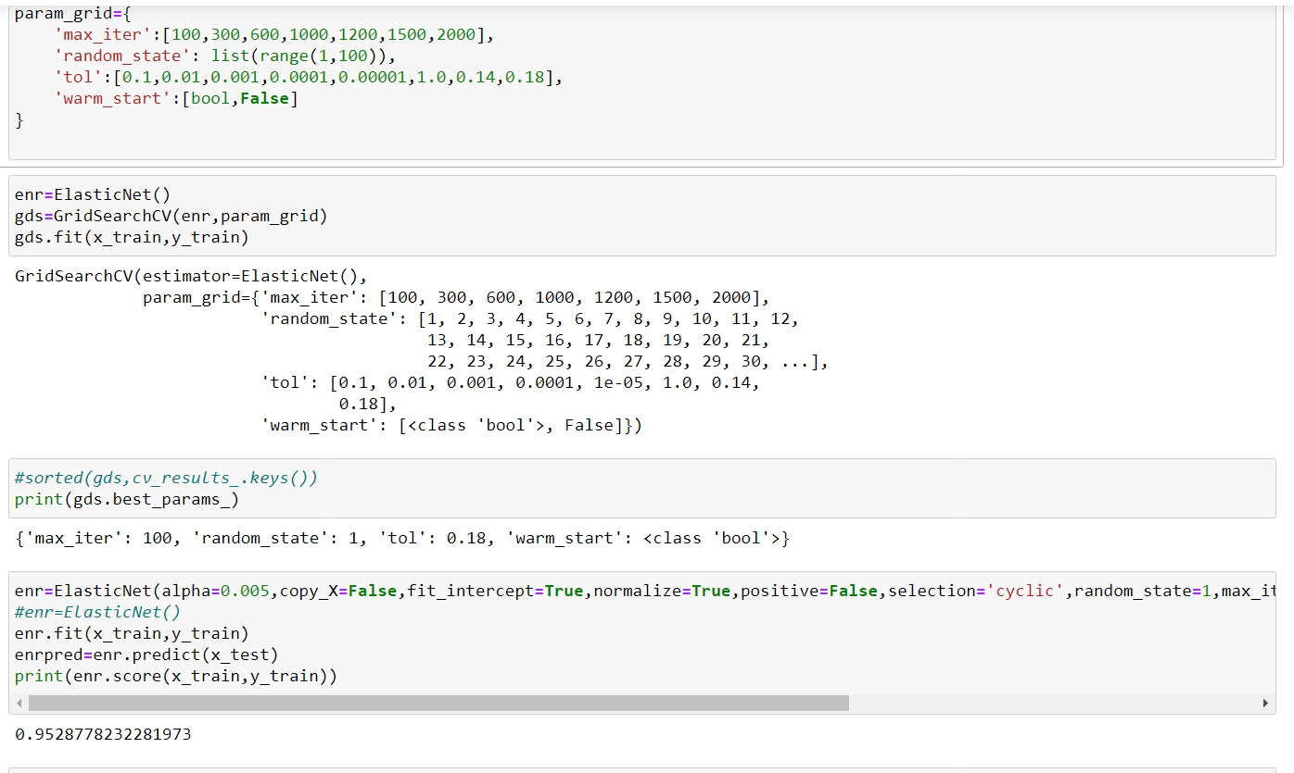
Searching for Effective Parameters

Slide 54
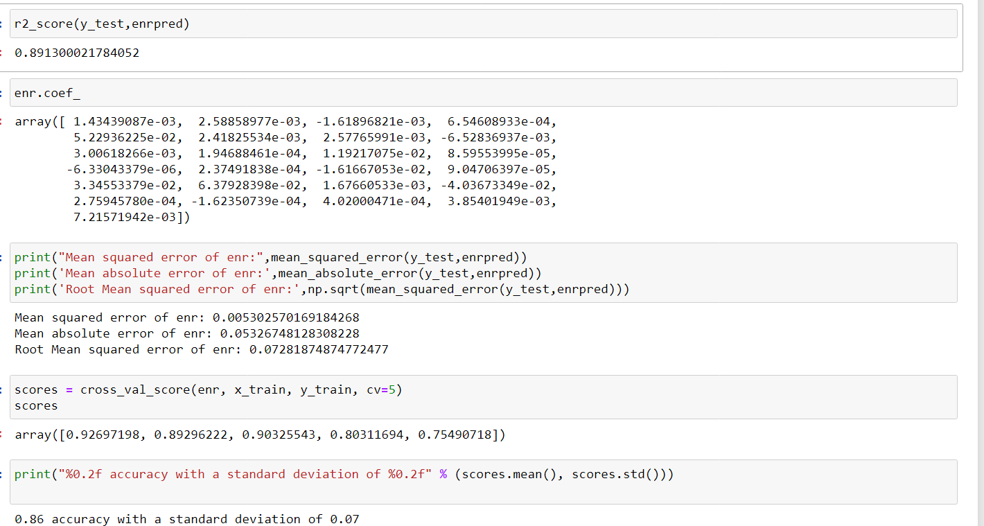
Model dashboards

Slide 55
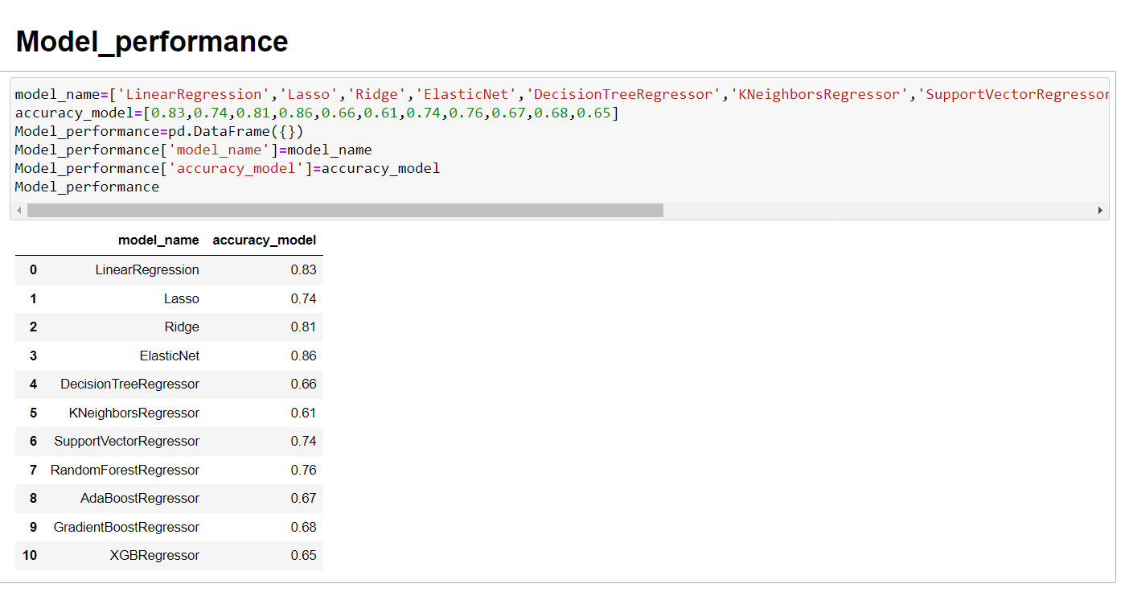
Analysis and Comparison
In the previous section, we created many models: for each model, we searched for good parameters then we constructed the model using those parameters, then trained (fitted) the model to our training data (X_train and y_train), then tested the model on our test data (X_test) and finally, we evaluated the model performance by comparing the model predictions with the true values in y_test. We used the Accuracy of the model to evaluate model performance.

Slide 56
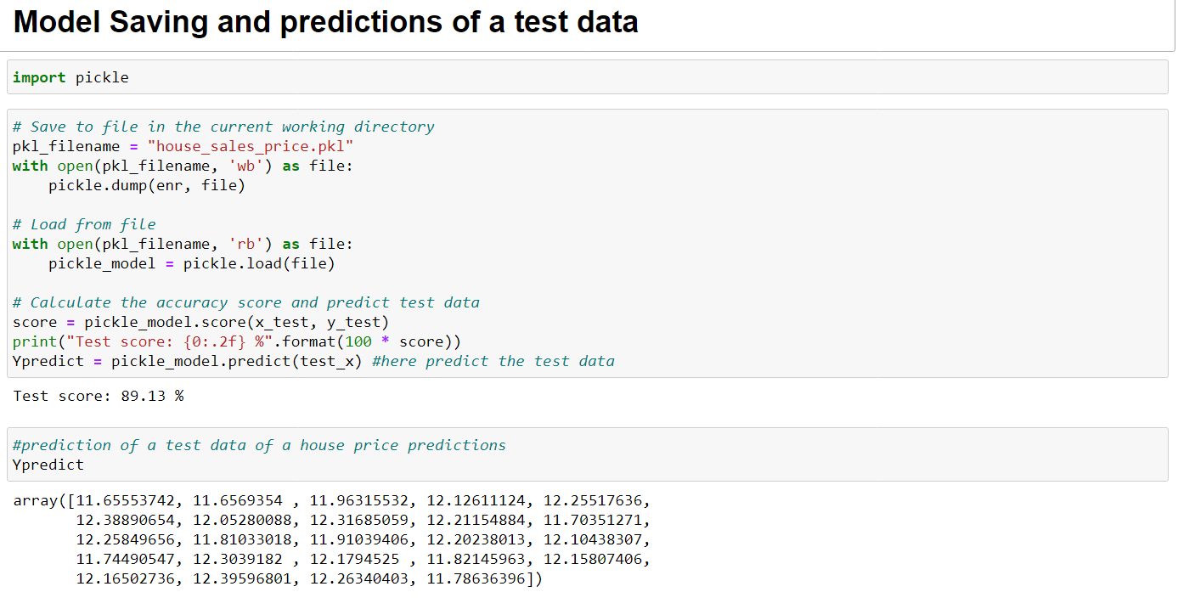
Model saving and predictions of a test data

Slide 57
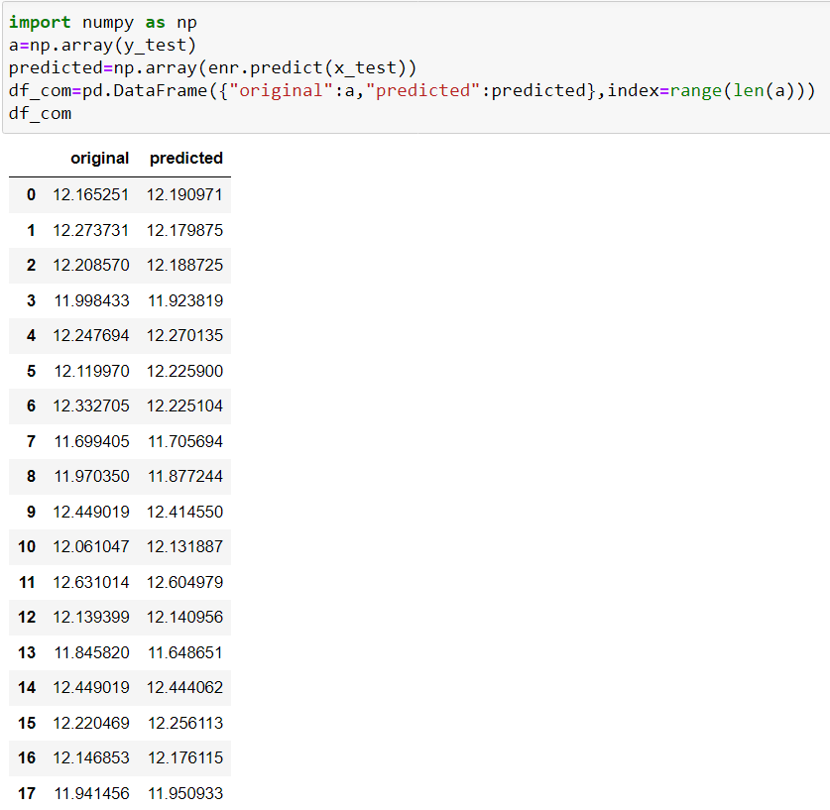
Conclusion
In this project, we built several regression models to predict the price of some house given some of the house features. We evaluated and compared each model to determine the one with highest performance. We also looked at how some models rank the features according to their importance. In this project, we followed the data science process starting with getting the data, then cleaning and preprocessing the data, followed by exploring the data and building models, then evaluating the results and communicating them with visualizations.
As a recommendation, we advise to use this model (or a version of it trained with more recent data) by people who want to buy a house in the area covered by the dataset to have an idea about the actual price. The model can be used also with datasets that cover different cities and areas provided that they contain the same features. We also suggest that people take into consideration the features that were deemed as most important as seen in the previous section; this might help them estimate the house price better.

Slide 58
References
Alkhatib, K., Najadat, H., Hmeidi, I., & Shatnawi, M. K. A. (2013). Stock price prediction using k-nearest neighbor (kNN) algorithm. International Journal of Business, Humanities and Technology, 3(3), 32-44.
de Abril, I. M., & Sugiyama, M. (2013). Winning the kaggle algorithmic trading challenge with the composition of many models and feature engineering. IEICE transactions on information and systems, 96(3), 742-745.
Feng, Y., & Jones, K. (2015, July). Comparing multilevel modeling and artificial neural networks in house price prediction. In Spatial Data Mining and Geographical Knowledge Services (ICSDM), 2015 2nd IEEE International Conference on (pp. 108-114). IEEE.
Hegazy, O., Soliman, O. S., & Salam, M. A. (2014). A machine learning model for stock market prediction. arXiv preprint arXiv:1402.7351.
Ticknor, J. L. (2013). A Bayesian regularized artificial neural network for stock market forecasting. Expert Systems with Applications, 40(14), 5501-550

Slide 59

The End
Thank you

